Slide 1

.styled-components
May 2021

Slide 2
Why styled-components.
Automatic critical CSS: Styled Components keeps track of which components are rendered on a page and injects their styles and nothing else, fully automatically. Combined with code splitting, this means your users load the least amount of code necessary.
No class name bugs: Styled Components generates unique class names for your styles. You never have to worry about duplication, overlap or misspellings.
Easier deletion of CSS: it can be hard to know whether a class name is used somewhere in your codebase. Styled Components makes it obvious, as every bit of styling is tied to a specific component. If the component is unused (which tooling can detect) and gets deleted, all its styles get deleted with it.

Slide 3
Why styled-components.
Simple dynamic styling: adapting the styling of a component based on its props or a global theme is simple and intuitive without having to manually manage dozens of classes.
Painless maintenance: you never have to hunt across different files to find the styling affecting your component, so maintenance is a piece of cake no matter how big your codebase is.

Slide 4
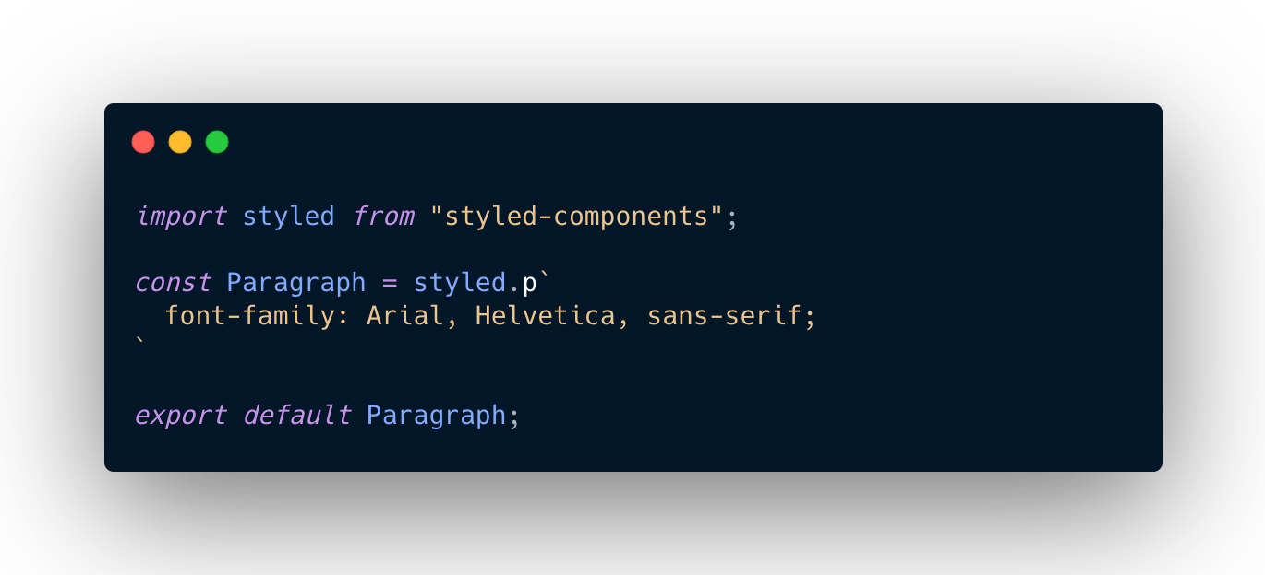
Basic Syntax.

Slide 5
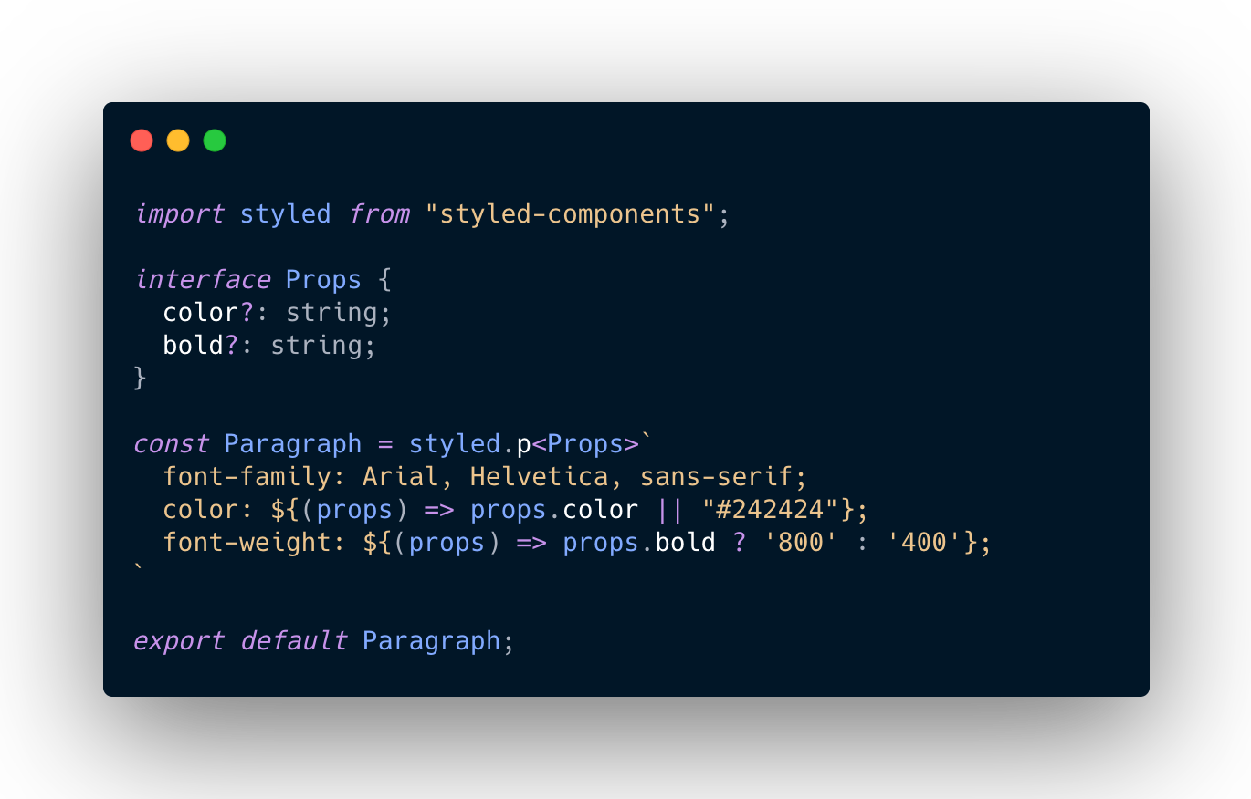
Using Props.

Slide 6
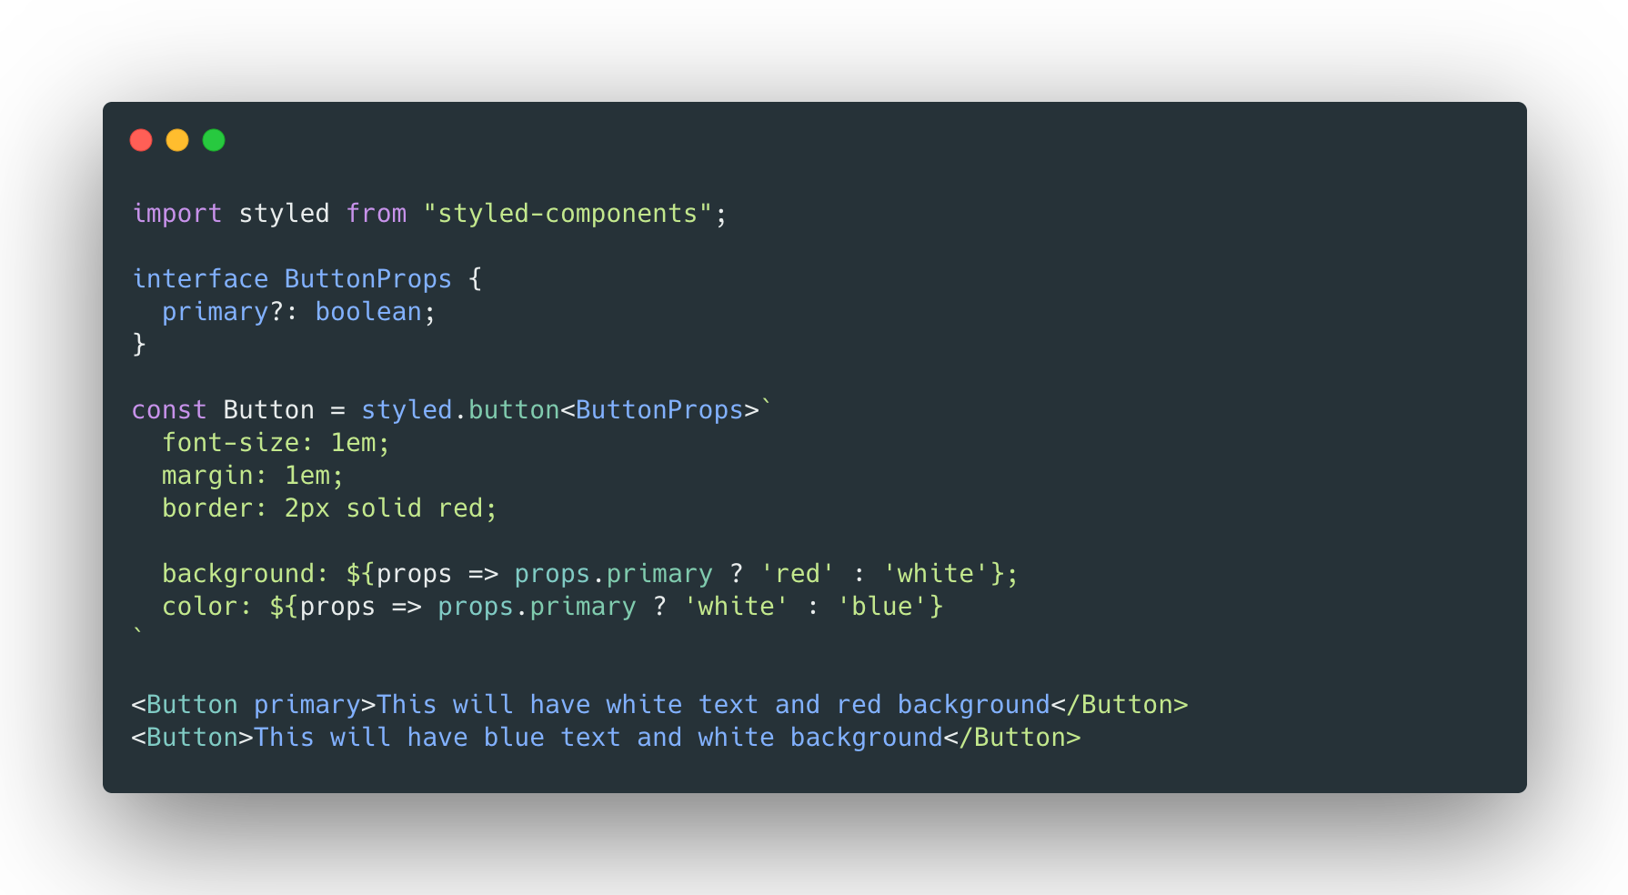
Using Props.

Slide 7
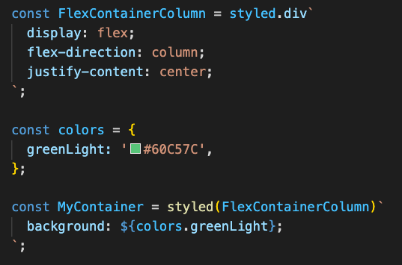
Inheritance

Slide 8
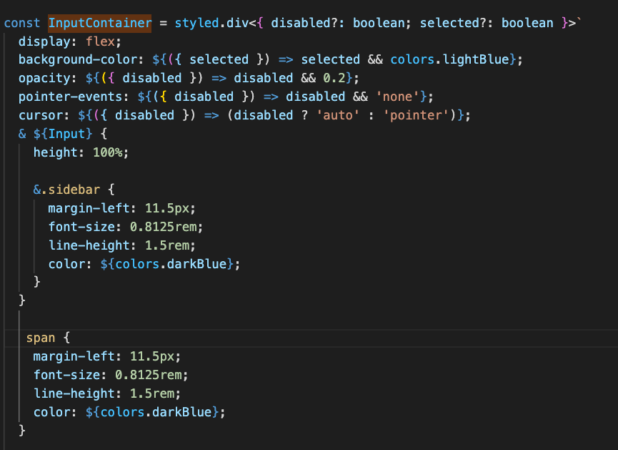
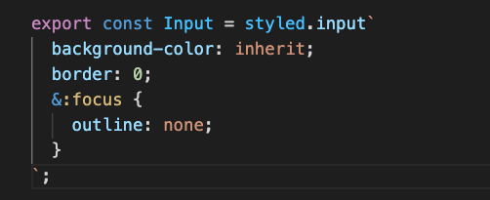
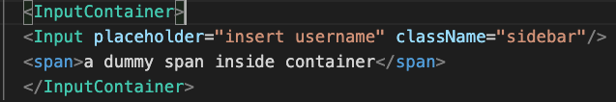
A Complexed example
SideBarStyles.tsx
CommonStyles.tsx
Sidebar.tsx

Slide 9
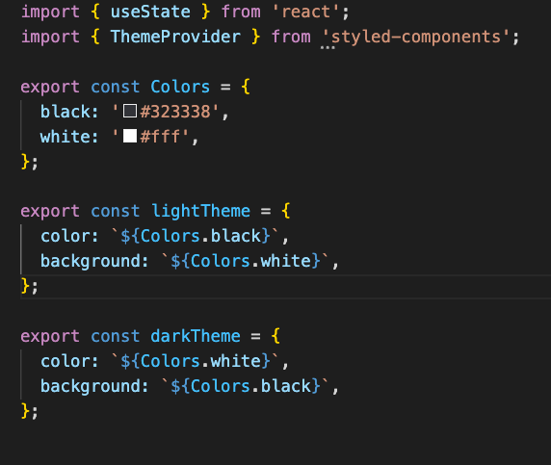
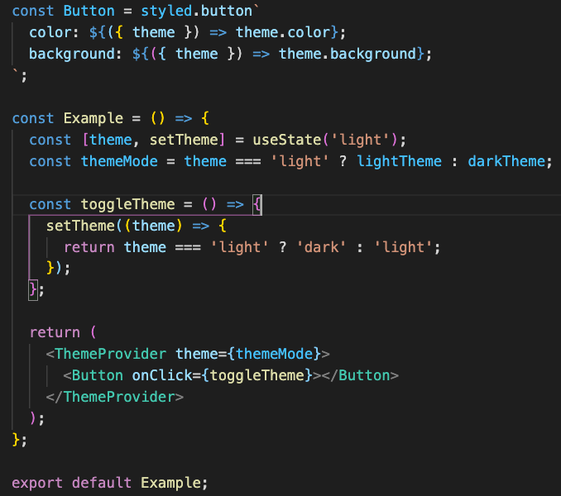
Theme Provider

Slide 10
References.
https://styled-components.com/docs/basics/ - Styled-components Basics
https://getstream.io/blog/styled-components-vs-css-stylesheets/#styled-components - styled-components vs css-stylesheets

